Slide 1
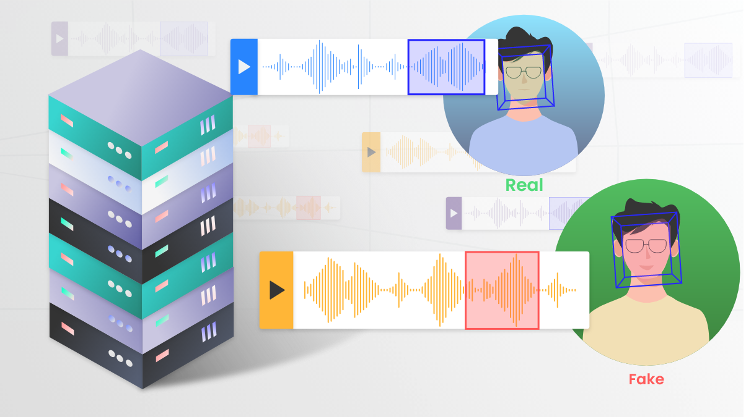
Defend DeepFake Audio & Audio Anonymization

Slide 2
Content Overview
How To Defend DeepFake Audio
Look at the defend through 3 perspectives
Audio Anonymization Methods
Goes over anonymization method in detail and compare their effectiveness
What Is Audio Anonymization
Potential risks associated with public sharing audio content and associated solutions
Relationship Between The Two
What is the difference, similarities between defend deepfake audio and audio anonymization
DeepFake Audio Defend Methods
Goes over each defend method in details and compare their effectiveness
Summary
Summary of important points covered

Slide 3
How To Defend DeepFake Audio
Why Need To Defend Against DeepFake Audio
Generated Synthetic audio empower criminals for spam calls, fraud, fake news, impersonation of individuals
Prevention
How to prevent DeepFake technologies from extracting useful speaker voice biometric to do voice cloning
Speaker Anonymization
Feature-based Approach
Image-based Approach
Human-Machine Difference Approach
Detection and Labelling
Detection
How to detect whether the given audio sample is DeepFake created or not
Reaction
How to raise individual’s awareness in aspects like to be more careful with information leaks and audio information encountered
Security Training Program
Secure Digital Profile

Slide 4
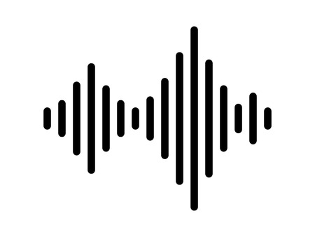
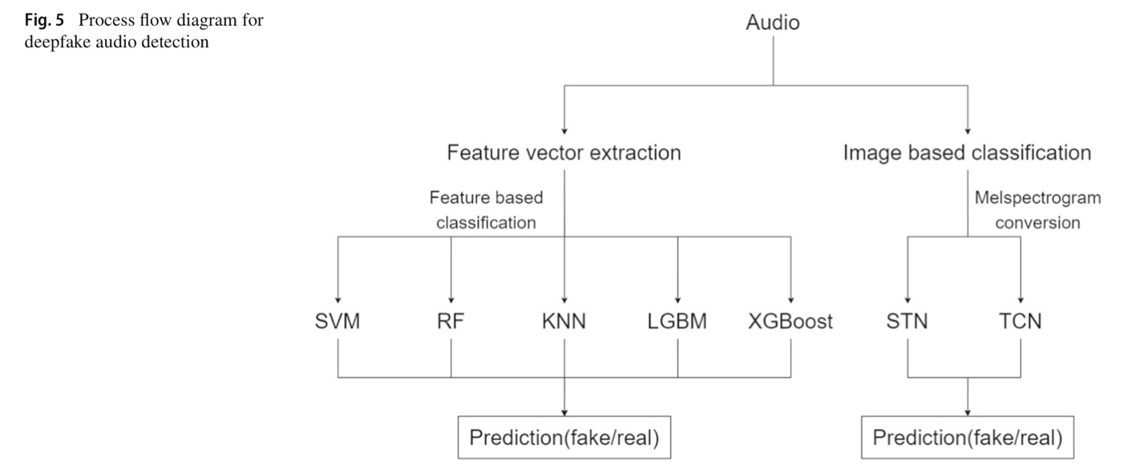
DeepFake Audio Defend Methods – Detection Feature Based Approach
Step 1.
Convert the audio file into the digital form of the audio file : a time series of the sampling rate
Step 2.
Extract 37 spectral features of the audio as a vector by performing feature vector extraction
Step 1,2 utilize librosa: a python package
Step 3.
Feed the 37 spectral features into the machine learning algorithms for the classification of audio as fake or real
SVM: Support Vector Machine
RF: Random Forest
KNN: K-Nearest Neighbors
LGBM: Light Gradient Boosting Machines
XGBoost: Extreme Gradient Boost
Hyperparameter Optimization: GridSearchCV

Slide 5
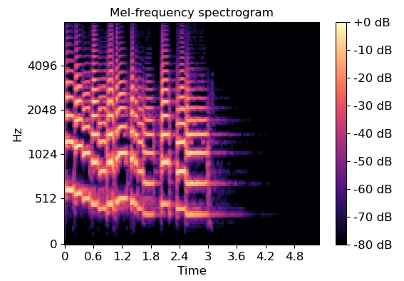
DeepFake Audio Defend Methods – Detection Image Based Approach
Step 1.
Convert the audio samples into melspectrograms
Melspectrograms
Graphic representation of signal strength in terms of signal’s intensity
Shows frequency variation of acoustic signals with respect to time
Step 2.
Input the melspectrograms into deep learning algorithms for classification
CNN: Convolutional Neural Networks
STN: Spatial Transformer Network
TCN: Temporal Convolutional Network

Slide 6
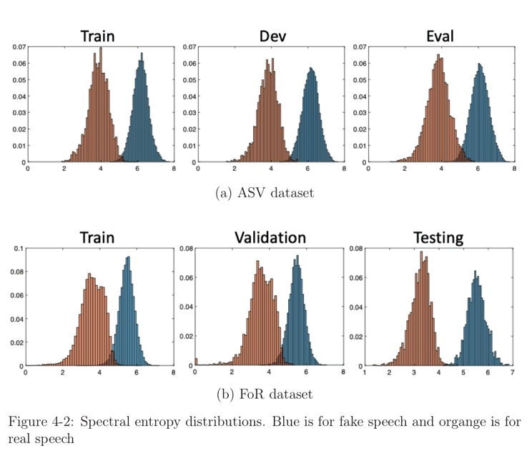
DeepFake Audio Defend Methods – Detection Human Machine Difference Approach
Characteristics of human Speech
Pitch, Formant, Jitter, Zero Crossing Rate
Inhalation sounds, breath sounds
Spectral Entropy of F0 Sequence
Based on comparison, the spectral entropy of F0 sequence is a good indicator that captures statistical difference between speech and natural speech across datasets
F0 sequence is trimmed to remove the zero values at the beginning and end of the sequence and then plotted the spectral entropy distribution
Spectral entropy is the spectral power distribution, is a measure of signal irregularity

Slide 7
DeepFake Audio Defend Methods – Detection Evaluation Metrics
Equal Error Rate (EER)
Pitch, Formant, Jitter, Zero Crossing Rate
Inhalation sounds, breath sounds
Precision
Pitch, Formant, Jitter, Zero Crossing Rate
Inhalation sounds, breath sounds
Tandem Detection Cost Function (t-DCF)
Pitch, Formant, Jitter, Zero Crossing Rate
Inhalation sounds, breath sounds
Recall
Pitch, Formant, Jitter, Zero Crossing Rate
Inhalation sounds, breath sounds
Test Accuracy
Pitch, Formant, Jitter, Zero Crossing Rate
Inhalation sounds, breath sounds
F-Score
Pitch, Formant, Jitter, Zero Crossing Rate
Inhalation sounds, breath sounds

Slide 8
DeepFake Audio Defend Methods – Detection Comparison of Approaches
Approach | Model | Test Accuracy
Feature Based Approach | SVM | 0.67
 | RF | 0.62
 | KNN | 0.62
 | XGBoost | 0.59
 | LGBM | 0.6
Image Based Approach | TCN | 0.92
 | STN | 0.8
Spectro-temporal Feature | CNN | 0.9-0.98
Conclusion
Image-based classification approach is better
Image-based features and distributions serves as better features.
Highest Accuracy 92% - 98% in use of global modulation feature and CNN based approach

Slide 9

DeepFake Audio Defend Methods – Reaction Security Training Program
Educate Employees for Verification Process
Attackers infiltrates the organization/company/ account by having the user click on malicious link
Enforce strict verification procedure
Practice verification even when recognize someone’s voice
Properly answer identify and react to suspicious calls
Sending a message through collaboration system for verification
Evaluate the Effectiveness
Test employees by having them receive live calls from trained professionals who can emulate the tactics of real attackers

Slide 10

DeepFake Audio Defend Methods – Reaction Secure Digital Profile
Secure Digital Profile
Keep software up to date (Security Updates
Routinely check privacy settings
Account Security: Multifactor authentication
Be careful with website navigation
Check validity of callers
Individual Awareness in Data Protection
Limiting public presence on social media
Enabling privacy restrictions
Prevent scammers from easily stealing your voice

Slide 11
What is Audio Anonymization
Why Need Audio Anonymization
Risk 1: Identity Privacy Breach
Risk 2: Speech Content Privacy Breach
Speaker Anonymization
How to remove or modify the voice biometrics of a speaker in an audio sample
Voice Conversion
Blur Method
Speech Content Desensitization
How to remove or modify the sensitive content in speech/conversations in an audio sample
Blur Method
Detect and Replace sensitive keywords

Slide 12
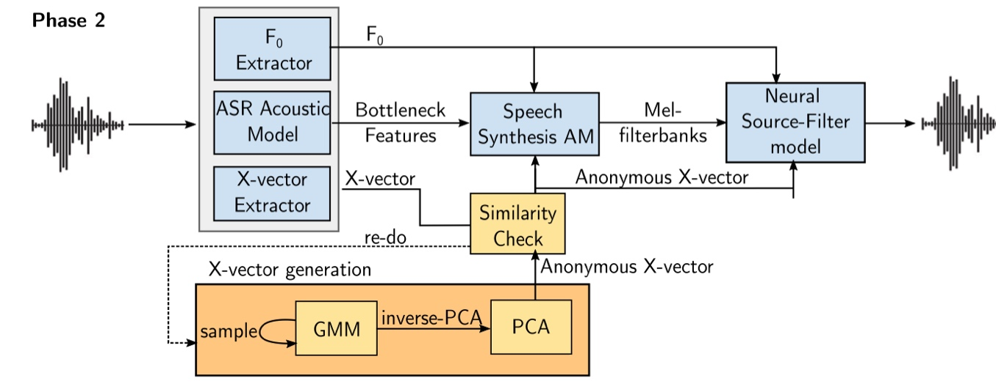
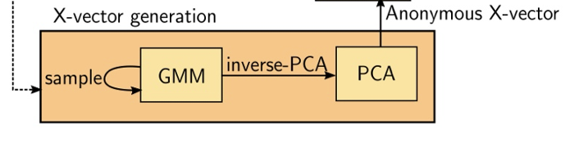
Speaker Anonymization – Voice Conversion GMM-PCA
Step 1.
Derive 3 components from the audio
X-vector extracted by TDNN(Time delay neural network) which represents the identity of the speaker (voice biometric)
The bottleneck features obtained by applying an automatic speech recognition acoustic model
Pitch Information (F0)
Step 2.
Generate a pseudo x-vector
Learn the properties of x-vector space using PCA (Principle Component Analysis
Fit a generative model on the reduced space using GMM(Gaussian Mixture Model)
Step 3.
Use a speech synthesis module: F0, BN features and the pseudo x-vectors to generate melspectrograms, output mel-filterbanks
NSF model process these filterbanks along with F0 and pseudo x-vector to generate anonymized audio
GMM: a probabilistic model that assumes all the data points are generated from a mixture of a finite number of Gaussian distribution with unknown parameters
PCA: PCA maps original data matrix onto an orthogonal space and let us extract a set of factors and then select a subset of those factors, reduce the dimensionality of the problem, those factors are the principle components (PCs) extracted through PCA)

Slide 13
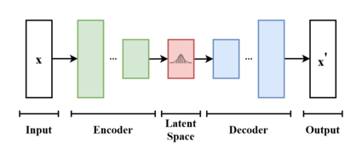
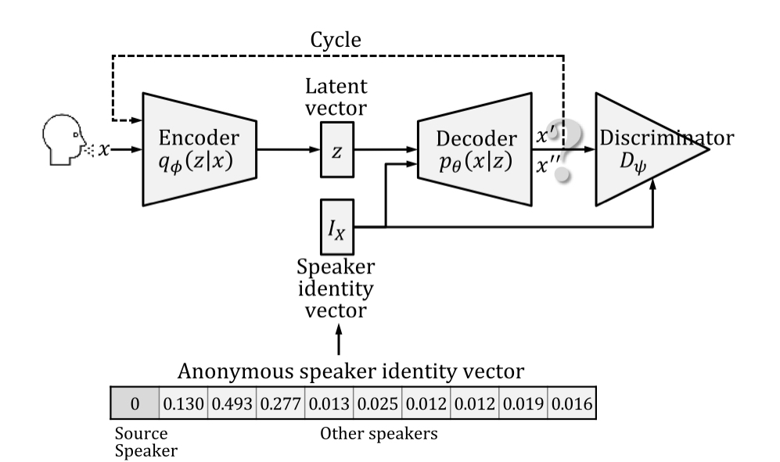
Speaker Anonymization – Voice Conversion CycleVAE-GAN
Variational Autoencoder (VAE)
The model receives x as input
The encoder compresses it into the latent space
The decoder receives the information sampled from the latent space and produce x’, the decoder aims to make x’ as similar as possible to x
the encoder is trained to extract latent vector z (contains the linguistic information of the input speech)
the decoder is trained to reconstruct the input speech from the latent vector z and the source speaker identity I­_{X}
Anonymous Speaker Identity Vector:
is fed into the decoding process of the VAE to convert the source speaker speech to the anonymous speaker speech
Uniform values: 1/(n-2), 2/(n-1)
Non-uniform values: k-fastest speaker, cosine similarity
Generative Adversarial Network (GAN)
The decoder of the VAE is considered as the generator of the GAN
The discriminator of GAN helps the generator (VAE decoder) to produce a speech similar to that of the target speaker

Slide 14
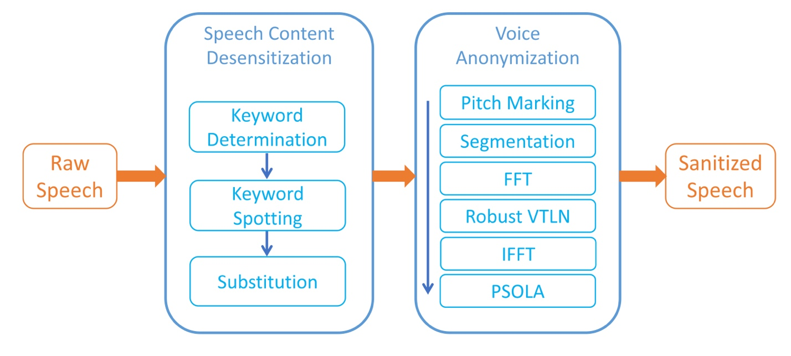
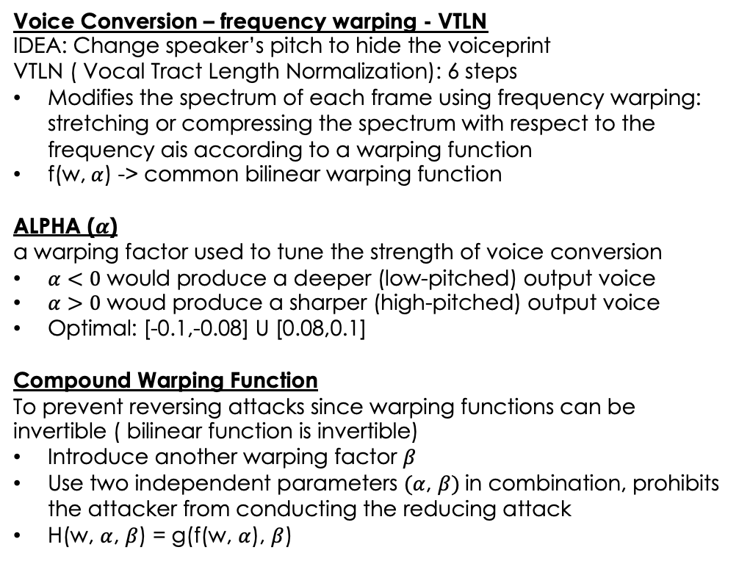
Speaker Anonymization – Voice Conversion
Pitch Modification
Voice Conversion – frequency warping - VTLN
IDEA: Change speaker’s pitch to hide the voiceprint
VTLN ( Vocal Tract Length Normalization): 6 steps
Modifies the spectrum of each frame using frequency warping: stretching or compressing the spectrum with respect to the frequency ais according to a warping function
f(w, $α$) -> common bilinear warping function
ALPHA ($α$)
a warping factor used to tune the strength of voice conversion
$α<0$ would produce a deeper (low-pitched) output voice
$α>0$ woud produce a sharper (high-pitched) output voice
Optimal: [-0.1,-0.08] U [0.08,0.1]
Compound Warping Function
To prevent reversing attacks since warping functions can be invertible ( bilinear function is invertible)
Introduce another warping factor $β$
Use two independent parameters $(α$, $β)$in combination, prohibits the attacker from conducting the reducing attack
H(w, $α$, $β$) = g(f(w, $α$), $β$)

Slide 15
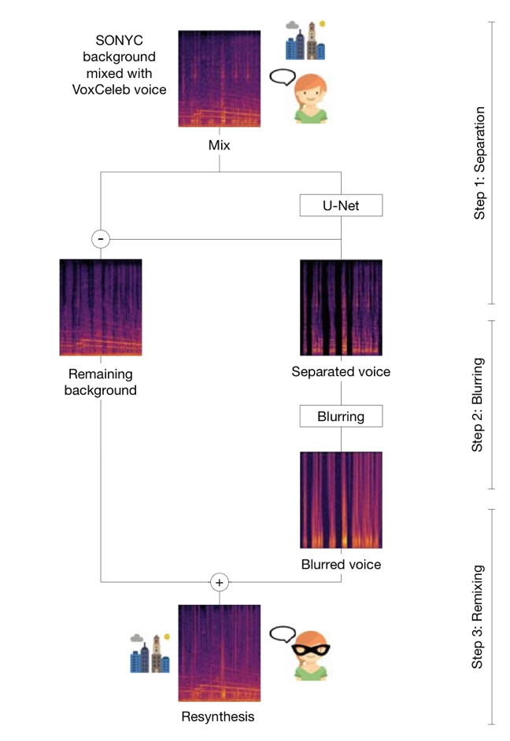
Speaker Anonymization and Content Desensitization Blur
Separtion of audio signal
Extract voices from the mix of voice and background using deep neural network (U-Net), separates into 2 audio signals: the voice and the residual background
Blur Method
Blur the separated voice to remove both speaker identifiable information and obscure linguistic content.
Low pass filtering
Filter passes low frequencies and blocks high frequencies
Most of the voice content is localized to the high frequencies
Low pass filter the separated voice at 250 Hz
MFCC Inversion
Mel-frequency cepstral coefficients (MFCCs) are coefficients that collectively make up an MFC.
Compute MFCC coefficient and choose to retain only the first 5 coefficients for inversion, which is insufficient for speech recognition but still capture the general spectral envelope
Resynthesis
Recombine the blurred voice with the background signals, resulting the anonymized resynthesis

Slide 16
Content Desensitization
Replace Sensitive Keywords
Sensitive keyword determination
Personalized keywords determination: A term with higher TF-IDF(term frequency-inverse document frequency) is more likely to reveal the person’s private information
Common keywords: Collect reports from users and estimate the frequency of each word
These two methods are complementary and both should be put into use together
Using DTW-based keyword spotting to localize sensitive words
DTW ( dynamic time warping)
1. Apply DTW algorithm to calculate the distance of two signals
2. Use cosine distance of the audio’s STFT features as the distance metric
Substitute with safe words
randomized safe word substitution
split a safe word set into different categories, after the keyword is detected, determine which category the keyword belongs to, and randomly picks a safe word from that category for the substitution

Slide 17
Audio Anonymization
Consideration
Linguistic Content
Background Sound
Desensitization
Blur
Replace Word
Speaker Anonymization
Voice Conversion – PCA-GMM
Voice Conversion – CycleVAE-GAN
Voice Conversion – VTLN
Blur

Slide 18
Audio Anonymization – Result and Comparison
Desensitization
Blur [ Successful]
Replace Word [ Keyword Detection Accuracy 90% ]
Speaker Anonymization
Voice Conversion – PCA-GMM [ Speaker Recognition: Successful] [ WER 0.36% - 6.69%]
Voice Conversion – CycleVAE-GAN [ Speaker Recognition 0.1-9.2%] [ Speech recognition Accuracy 78.2%-81.3%]
Voice Conversion – VTLN [ Speaker Recognition 20%] [ Speech recognition Accuracy 72%-75%]
Blur [ Speaker Recognition 29%]

Slide 19
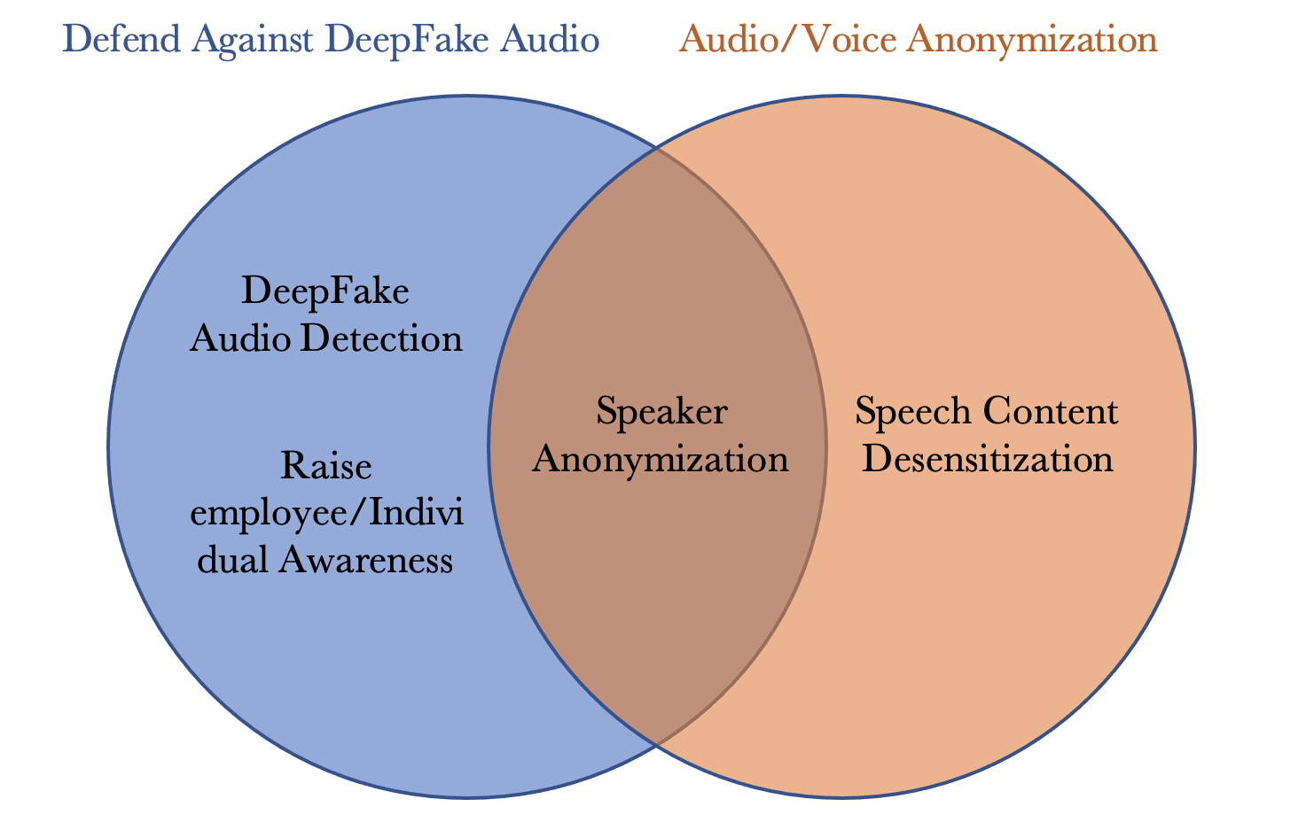
Relationship Between the Two

Slide 20

Summary
Defend DeepFake Audio
Image-Based Feature Classification
Speaker Anonymization
Voice Conversion
Audio Anonymization
Consideration Factors

Slide 21
References
[1] Seorg, “Deepfakes: How to defend yourself from attack,” Security Boulevard, 20-May-2020. [Online]. Available: https://securityboulevard.com/2020/05/deepfakes-how-to-defend-yourself-from-attack/.
[2] Social-Engineer, “Secure it – keep your digital profile safe from Vishers and phishers,” Social, 20-Nov-2020. [Online]. Available: https://www.social-engineer.com/secure-it-keep-your-digital-profile-safe-from-vishers-and-phishers/.
[3] J. Vincent, “Deepfake detection algorithms will never be enough,” The Verge, 27-Jun-2019. [Online]. Available: https://www.theverge.com/2019/6/27/18715235/deepfake-detection-ai-algorithms-accuracy-will-they-ever-work.
[4] K. Waddell, “Researchers are figuring out how to detect audio deepfakes before it's too late,” Axios, 03-Apr-2019. [Online]. Available: https://www.axios.com/2019/04/03/deepfake-audio-ai-impersonators.
[5] K. Waddell, “This ai-generated Ellen DeGeneres Voice is the future of deepfakes,” Axios, 03-Apr-2019. [Online]. Available: https://www.axios.com/2019/04/03/deepfake-audio-ai-ellen-degeneres.
[6] C. Franklin, “Defending against deepfakes: From tells to crypto,” Dark Reading, 17-Sep-2020. [Online]. Available: https://www.darkreading.com/edge/defending-against-deepfakes-from-tells-to-crypto.
[7] J. Khochare, C. Joshi, B. Yenarkar, S. Suratkar, and F. Kazi, “A Deep Learning Framework for Audio Deepfake Detection,” Arabian journal for science and engineering (2011), vol. 47, no. 3, pp. 3447–3458, 2021, doi: 10.1007/s13369-021-06297-w.
[8] “Precision and recall in Machine Learning - Javatpoint.” [Online]. Available: https://www.javatpoint.com/precision-and-recall-in-machine-learning.
[9] “F-score,” DeepAI, 17-May-2019. [Online]. Available: https://deepai.org/machine-learning-glossary-and-terms/f-score#:~:text=The%20F%2Dscore%2C%20also%20called,positive'%20or%20'negative'.
[10] R. Reimao and V. Tzerpos, "FoR: A Dataset for Synthetic Speech Detection," 2019 International Conference on Speech Technology and Human-Computer Dialogue (SpeD), 2019, pp. 1-10, doi: 10.1109/SPED.2019.8906599.
[11] Y. Gao, “Audio Deepfake Detection Based on Differences in Human and Machine
Generated Speech,” ProQuest Dissertations Publishing, 2022.
[12] “Equal error rate (EER) - biometric glossary,” Innovatrics, 05-May-2021. [Online]. Available: https://www.innovatrics.com/glossary/equal-error-rate-eer/.
[13] N. M. Müller, P. Czempin, F. Dieckmann, A. Froghyar, and K. Böttinger, “Does Audio Deepfake Detection Generalize?,” 2022.
[14] T. Kinnunen, K. A. Lee, H. Delgado, N. Evans, M. Todisco, M. Sahidullah, J. Yamagishi, and D. A. Reynolds, “T-DCF: A detection cost function for the tandem assessment of spoofing countermeasures and automatic speaker verification,” The Speaker and Language Recognition Workshop (Odyssey 2018), 2018.
[15] I.-C. Yoo, K. Lee, S. Leem, H. Oh, B. Ko, and D. Yook, “Speaker Anonymization for Personal Information Protection Using Voice Conversion Techniques,” IEEE access, vol. 8, pp. 198637–198645, 2020, doi: 10.1109/ACCESS.2020.3035416.
[16] H. Turner, G. Lovisotto, and I. Martinovic, “Generating identities with mixture models for speaker anonymization,” Computer speech & language, vol. 72, p. 101318–, 2022, doi: 10.1016/j.csl.2021.101318.
[17] A. Cohen-Hadria, M. Cartwright, B. McFee, and J. P. Bello, “Voice Anonymization in Urban Sound Recordings,” in 2019 IEEE 29th International Workshop on Machine Learning for Signal Processing (MLSP), 2019, pp. 1–6. doi: 10.1109/MLSP.2019.8918913.
[18] J. Qian, H. Du, J. Hou, L. Chen, T. Jung, and X.-Y. Li, “Speech Sanitizer: Speech Content Desensitization and Voice Anonymization,” IEEE transactions on dependable and secure computing, vol. 18, no. 6, pp. 2631–2642, 2021, doi: 10.1109/TDSC.2019.2960239.

